Slide 1
A transfer Learning Approach for Generating Bangla captioning From Image
Group Members:
Lamima Tabassum Ava (ID: 17182103281)
Ruma Akter (ID: 17182103285)
Md. Emon Hossain (ID: 17182103310)
Shibdad Mahadi (ID:17182103047)
Md Tanvir Ahmed (ID:16172103425)

Slide 2
Supervised by
T.M. Amir-Ul-Haque Bhuiyan
Assistant Professor
Dept of CSE
Bangladesh University of Business and Technology(BUBT)

Slide 3
Project background
Not many deep learning AI applications in Bangla language
Combination of NLP & Computer Vision
So we proposed a Transfer Learning based Hybrid model (RESNET 152+BI-LSTM) to create an image captioning System in Bangla
Make something to help the people in optimal Real-Life Solution

Slide 4

Overview
Our project is an image captioning program in Bangla which is a first step of using (RESNET-152+Bi-LSTM)
It is designed to help disabled people get a sense of their surroundings
It is going to be implemented as a web app and a mobile app (In future)
It uses deep neural network to correctly predict the contents of a picture and provide an accurate caption

Slide 5

workflow
Collect and Create
Collect and create a huge set of images (10,000 images) and generating one Caption for each image
Preprocess
Preprocess the image and text to fit the neural network model
Extract the Features
Develop and train the model
Train the proposed model
Evaluate the result
Result Analysis
Develop the web app and mobile app

Slide 6

The nobility of our project
We developed a hybrid model for this project (RESNET 152+ BIDIRECTIONAL LSTM)
01
Resnet-152 is the latest version RESNET family. This model have a very deep network up to 152 layers.
02
The bidirectional LSTM generating the Bangla captions(both left to right and right to left)
03
In this paper we used Bangla BERT tokenizer
04
We created our own dataset that have 10000 images from Bengali lifestyles, cultural and Festive
05

Slide 7
Dataset
Collect more than 10,000 images from various sources
Caption each of the collected images
Use the captions for word embedding and Applying Bangla BERT tokenizer

Slide 8
Preprocessing
Dataset
Convert all the images RGBA Format and RESIZE Them(224,224)also repair the blur photos and removed logos and noise from the images
Save all the image in JPG
Applying Bangla BERT tokenizer
Removed punctuations

Slide 9
Show and tell
Different model used for extracted features from the image
Uses a multilayered Long Short-Term Memory (LSTM)
One LSTM is used to read the input sequence to obtain large fixed-dimensional vector
Another LSTM is used to extract the output sequence from that vector
It can learn data with a long-range temporal dependencies
The model stops making predictions after it reaches the end of sentence token

Slide 10
80% Training
10% Validation
10% Testing
Split the
Dataset

Slide 11
Deep learning models
Sequence to Sequence
Word Embedding
CNN as Encoder
RNN as Decoder

Slide 12
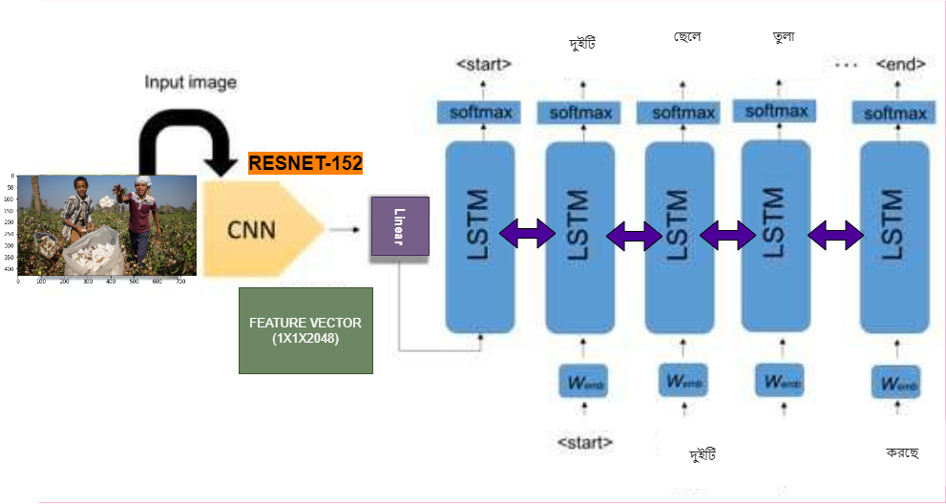
Our Proposed model[Architecture]
Input image: 224px224pixels
RESNET-152 (CNN) Encoder
BI-LSTM (RNN) Decoder
Output: Image Caption

Slide 13
Attention on Attention
Also an encoder-decoder based model
Image is first encoded via a CNN-based network to a set of feature vectors
Decoded to words via an RNN-based network
Expands the traditional frameworks of attention to assess the connection between the effects of attention and the queries

Slide 14


Attention on Attention (Architecture)
Encoder
Decoder
CNN based network
Receive the pre-processed images
Extracts feature vectors of objects in the image
Applies AoA to determine how the objects are related to each other
An RNN-based network
Takes the output from the encoder
Uses AoA to filter out the irrelevant results and keep only the useful information
Produce the caption

Slide 15
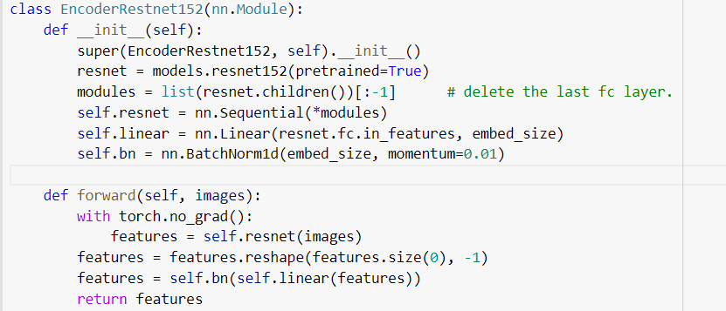
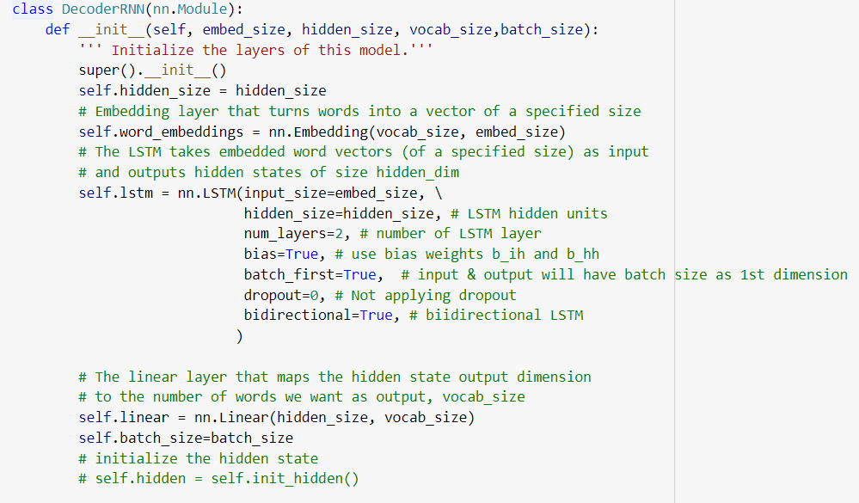
Snapshots of ENCODER &DECODER
ENCODER PART
DECODER PART

Slide 16
Outcome
Model | BLEU-1 | BLEU-2 | BLEU-3 | BLEU-4
VGG-16 + Bilstm | 0.36 | 0.37 | 0.66 | 0.33
VGG-19 + Bilstm | 0.37 | 0.47 | 0.46 | 0.43
RESNET-50 + Bilstm | 0.56 | 0.67 | 0.55 | 0.37
RESNET-101+ Bilstm | 0.75 | 0.66 | 0.56 | 0.45
RESNET-152 + Bilstm | 0.88 | 0.76 | 0.36 | 0.66

Slide 17
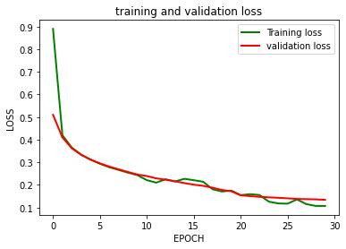
Outcome

Slide 18
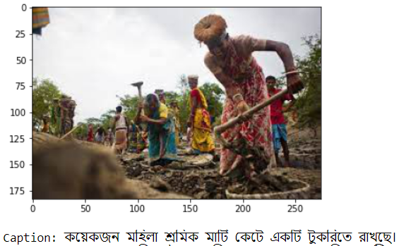
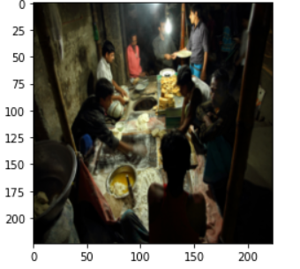
OUTCOME
TEST IMAGE:1
TEST IMAGE: 2

Slide 19
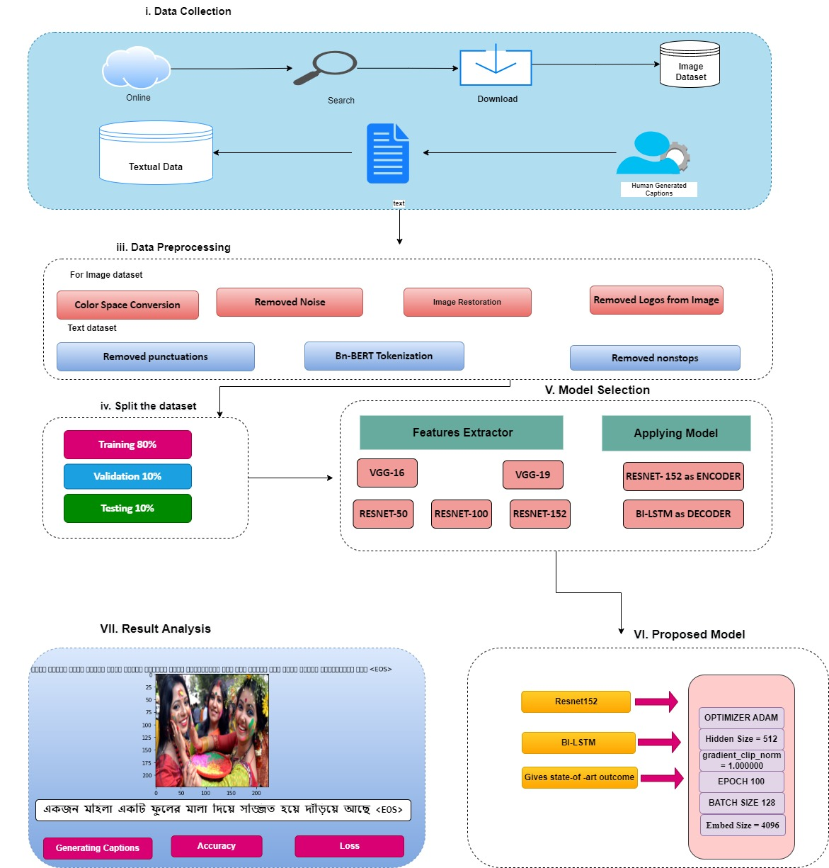
Workflow

Slide 20
(Advantages)
It would be allow for the integration of various object detectors
01
Variety of captions can be produced for the same image using different detection backends
02
It has the ability to generate captions for novel objects also drones
03

Slide 21
(Limitations)
Generating only one captions
Doesn’t make use of bounding box annotation
Simple dataset

Slide 22
Future work
Developed the web or mobile app
Try to improve the model performance
10 Captions

Slide 23

Thank You

